Slide 1
Carpool-Go!
Team: FPG
Date: 2018.10.26

Slide 2
01.
What
An internal ridesharing system.
CONTENTS
02.
Why
The problems
Others
03.
How
Benefit
Demo in #Red
Sustainability

Slide 3
PART 01
What
An internal ridesharing system

Slide 4

1.1 What
An internal ridesharing system.
A Platform that benefits all HSBC folks commute from home to work

Slide 5
PART 02
Why
The problems

Slide 6
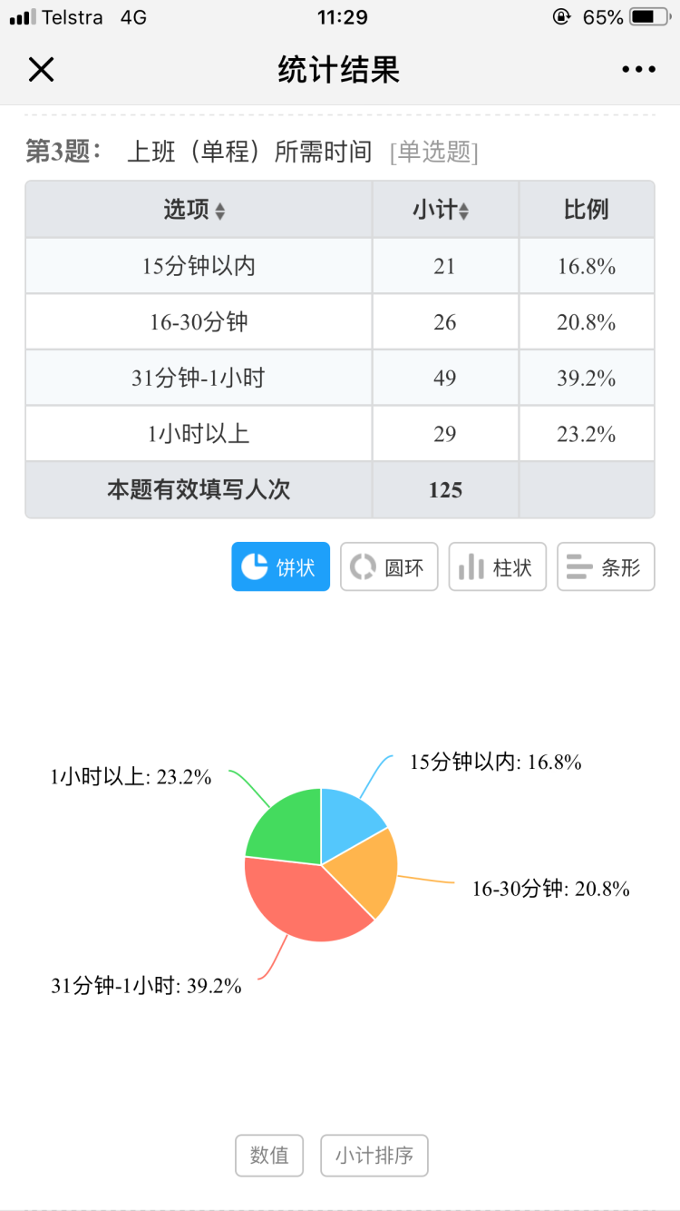
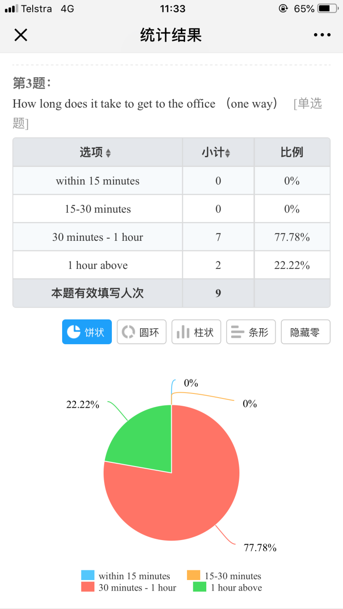
2.1 The problems
2.1.1 Time
Notes:
The majority of HSBC colleague spend more than 30 mins in commuting

Slide 7
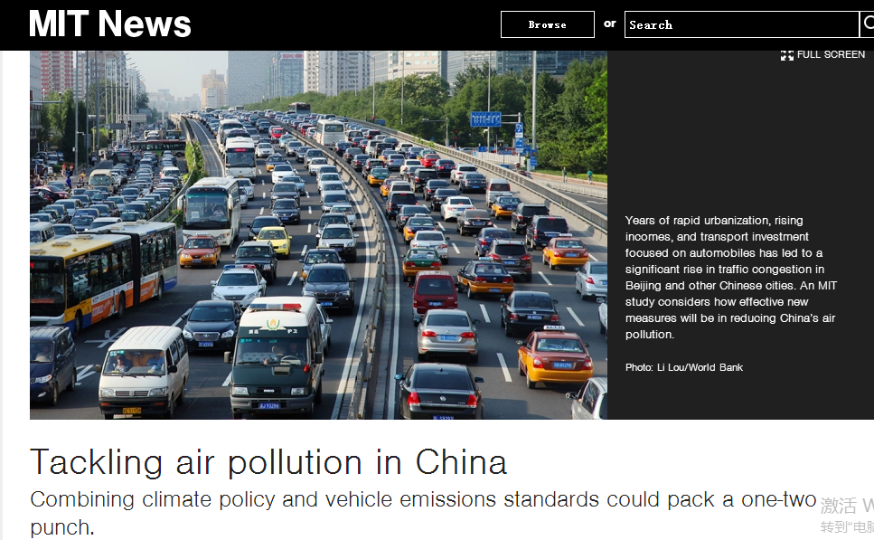
2.1 The problems
2.1.2 Traffic Jam & Pollution
Notes:
vehicle emission is one of the reason of poor air quality, Climate change, global warming, resource exhaust

Slide 8
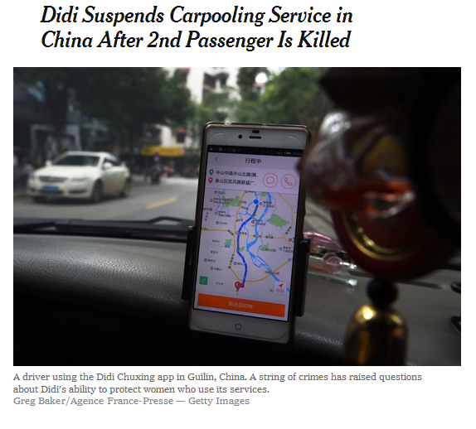

2.1 The problems
2.1.3 Safety
?
Identification? Safe?
Notes:
Can identify the driver, driver’s personality, don’t know what kind of people are giving you a ride.
Poor driver’s background check, everybody can be a driver as long as your have license (sometime maybe not)

Slide 9
PART 03
How
Solution
Demo in #Red
Sustainability

Slide 10
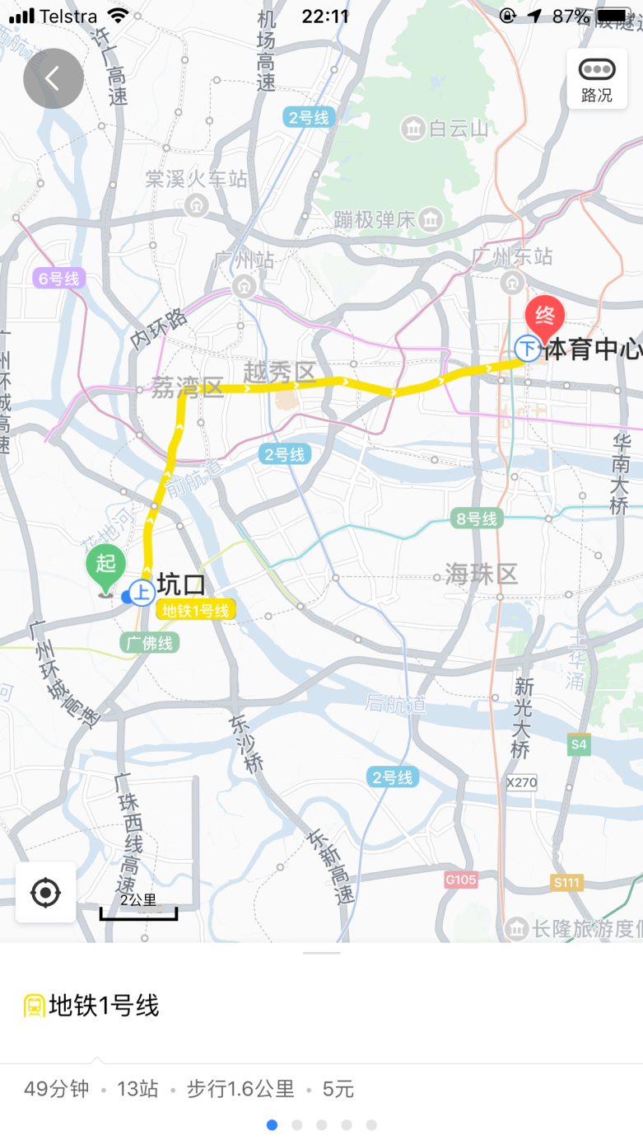
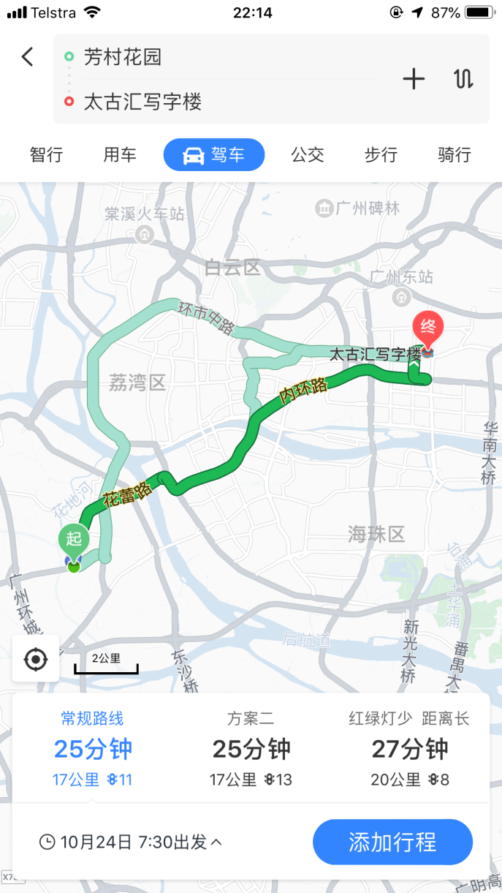
3.1 Solution
3.1.1 Time
Comparison - TKH
Metro
Drive
Notes:
Times saving example. 49 mins > 25 mins

Slide 11
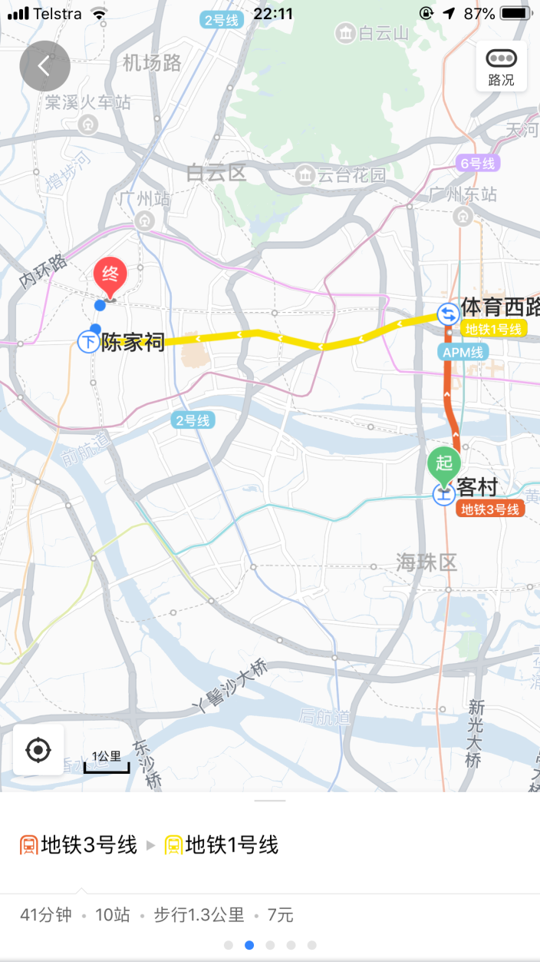
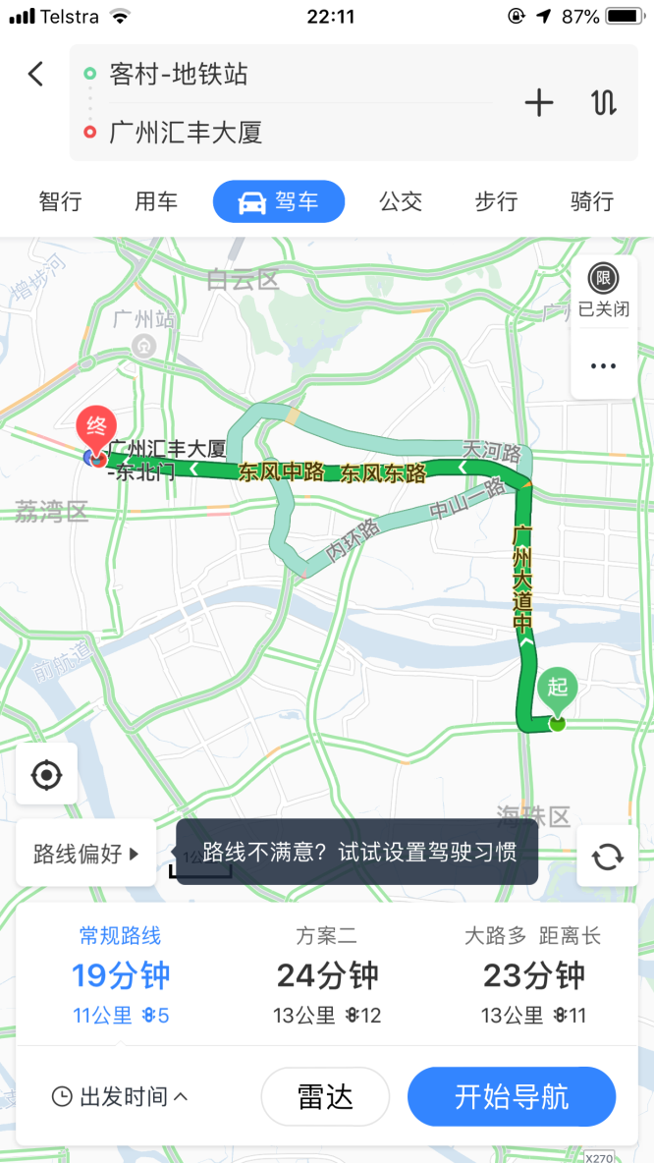
3.1 Solution
3.1.1 Time
Comparison - GZC
Metro
Drive
Notes:
Example 2 41mins >19mins

Slide 12
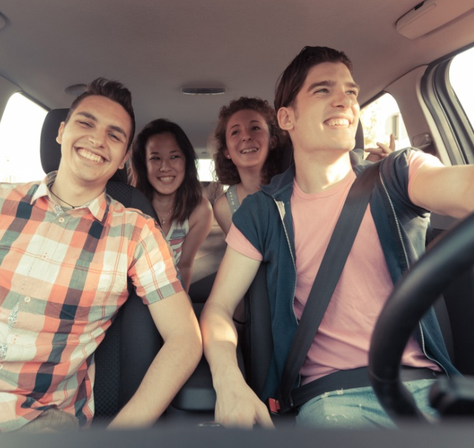
3.1 Solution
3.1.2 Traffic Jam & Pollution
LESS EMISSION
Less cars on the road means less gas being used and less harmful pollutants being emitted into the air.
Take advantage of similar schedules and share the cost of getting everyone in your colleague where they need to be.
LESS STRESS
Notes:
Less stress. freeing up space on the road, The more people who carpool in a community, the less congestion on the roads!
Less emission. Prevent global warming, improve the air quality

Slide 13

3.1 Solution
3.1.3 Safety
Background Check
First Advantage
Good credit
Values Assessment Quiz
Internal Only
Notes:
Background Check: 1.First Advantage (vendor), the largest provider of employment background screening services in the Asia Pacific region
2.Good credit, bank will never hire people who have doubtful integrity and lack of trustworthiness, person who with no financial problem.
Values Assessment Quiz : every colleagues have to finish this quiz before the get a job from HSBC
Internal only : HSBC employee can access #Red APP, easy to identify and locate the driver and passenger if there is emergency.

Slide 14

3.2 Demo in #Red
3.2.1 Carpool-Go
Keybo

Slide 15
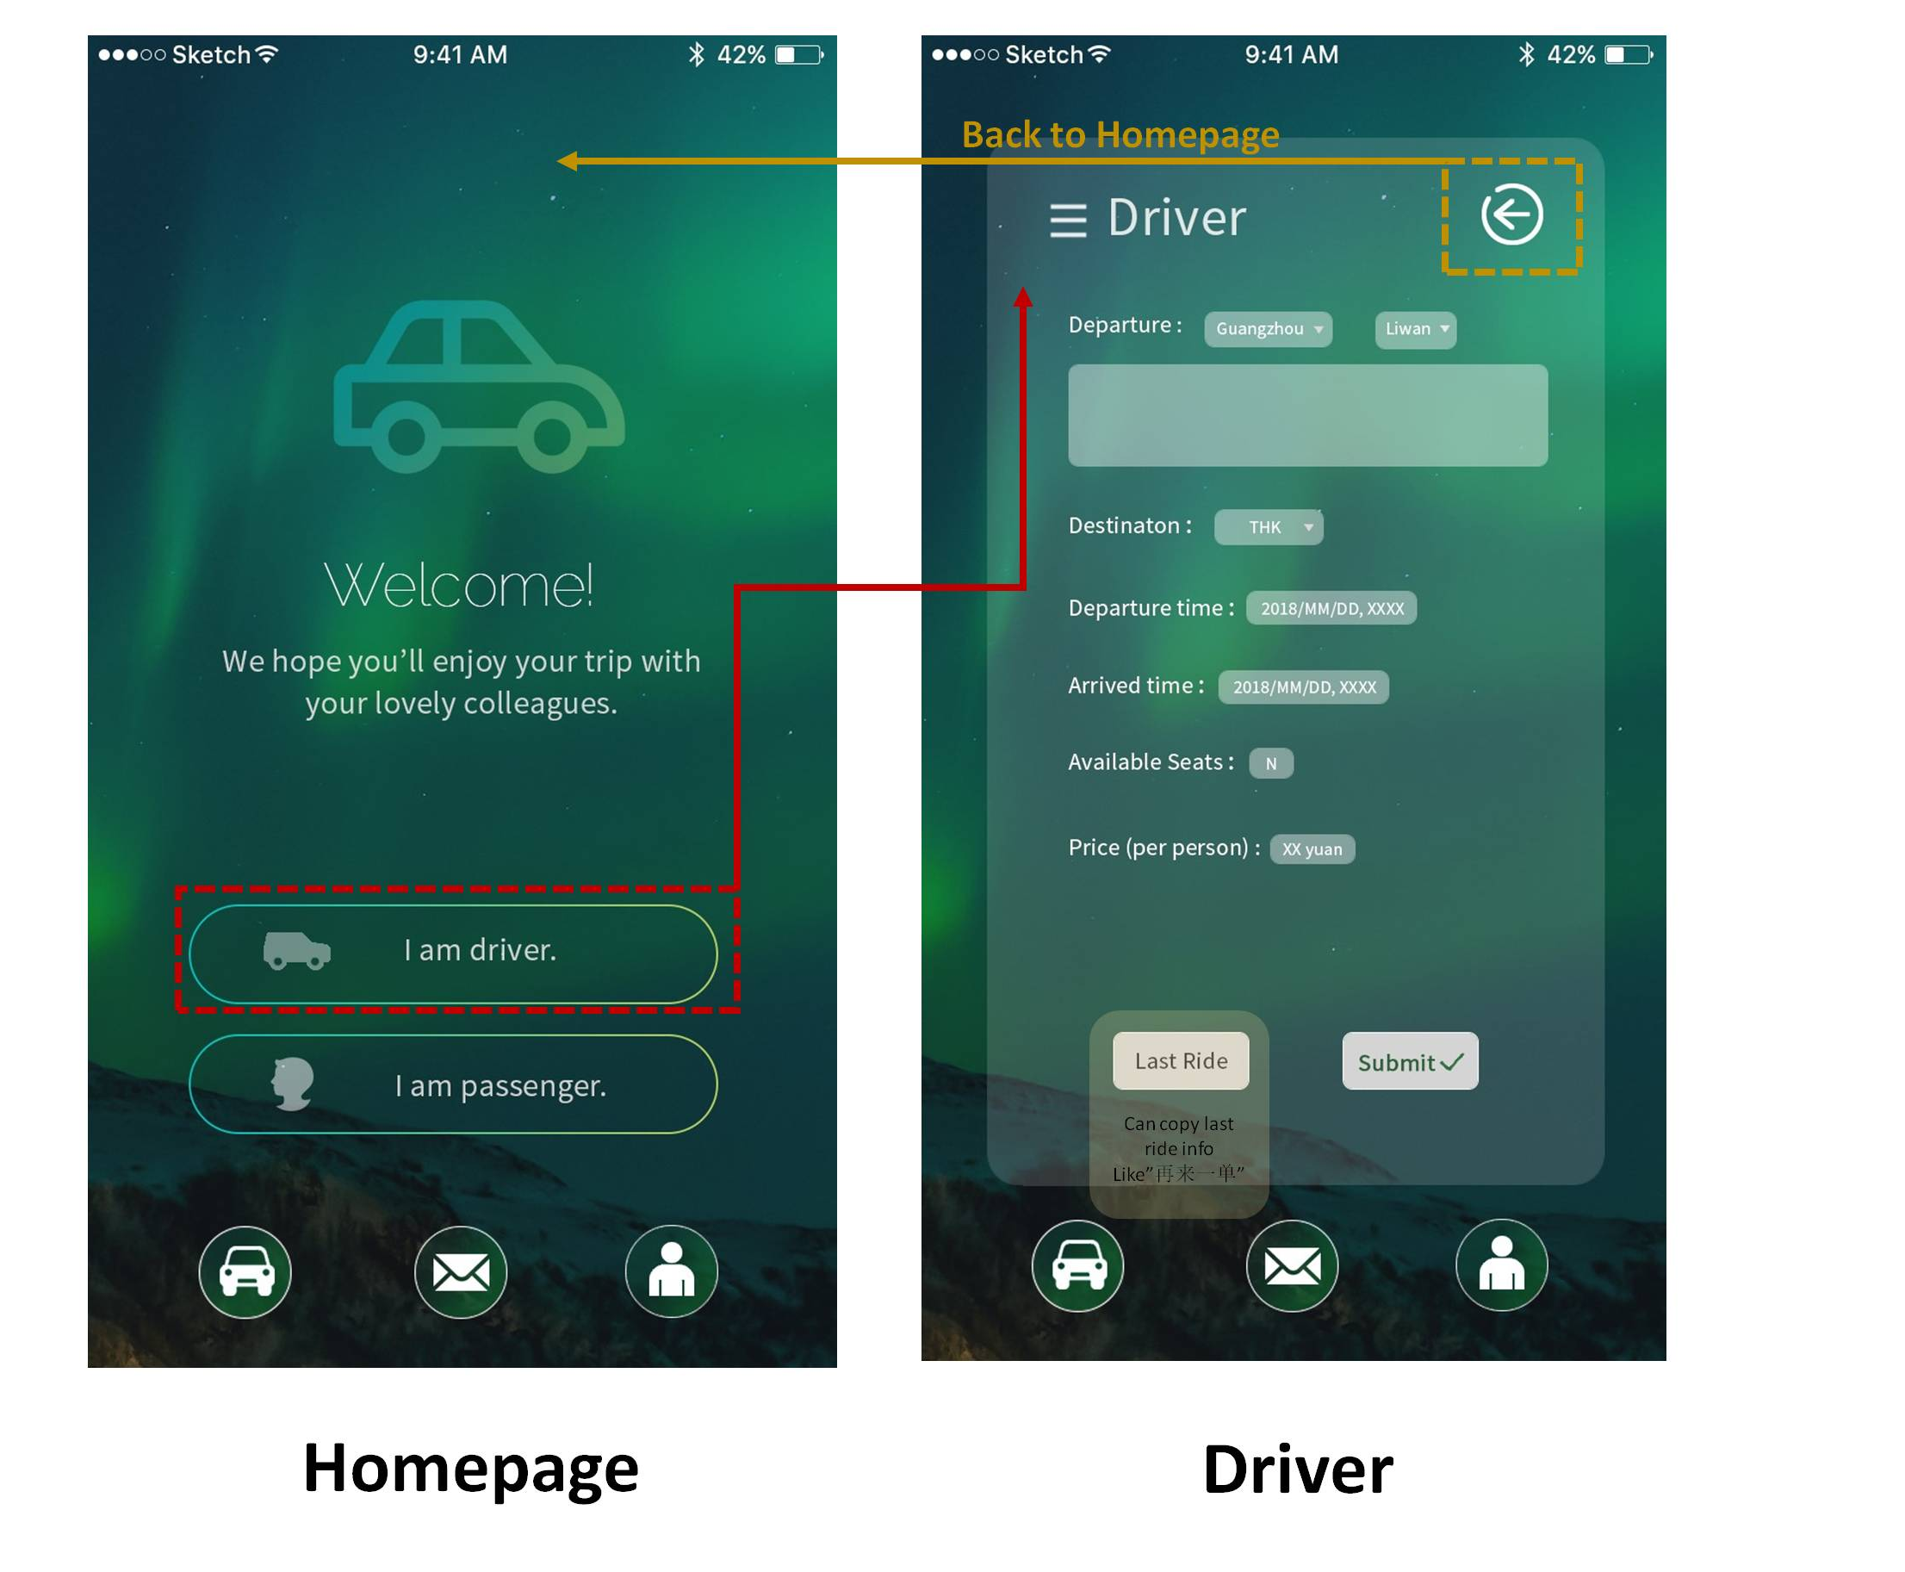
3.2 Demo in #Red
3.2.1 Carpool-Go

Slide 16
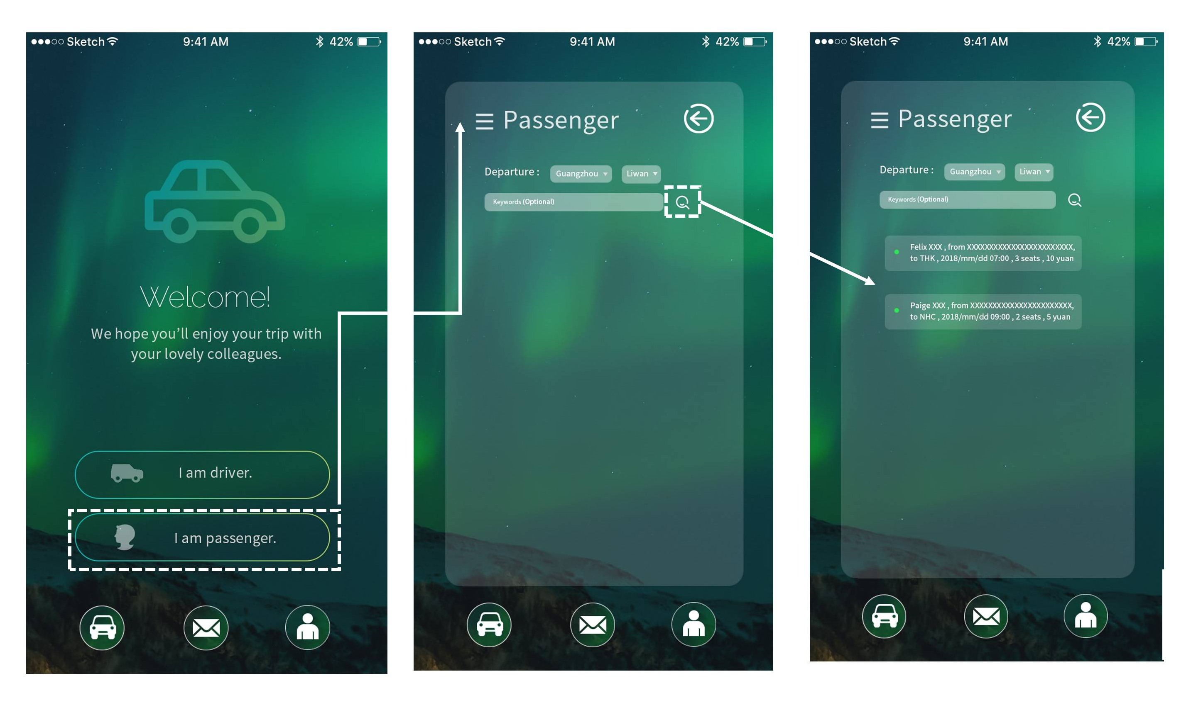
3.2 Demo in #Red
3.2.1 Carpool-Go

Slide 17
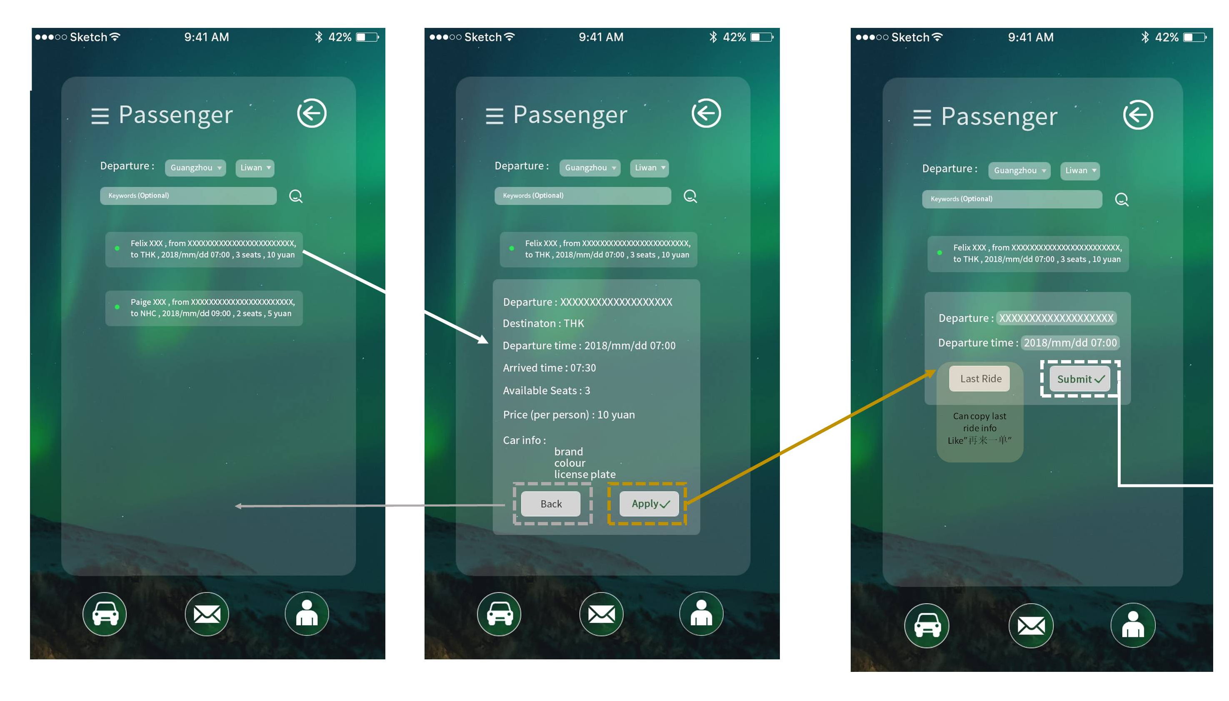
3.2 Demo in #Red
3.2.1 Carpool-Go

Slide 18
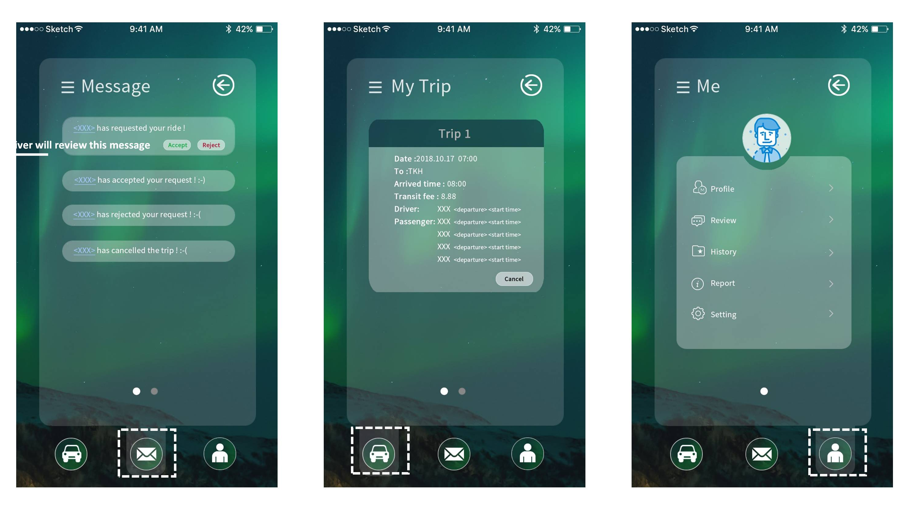
3.2 Demo in #Red
3.2.1 Carpool-Go

Slide 19
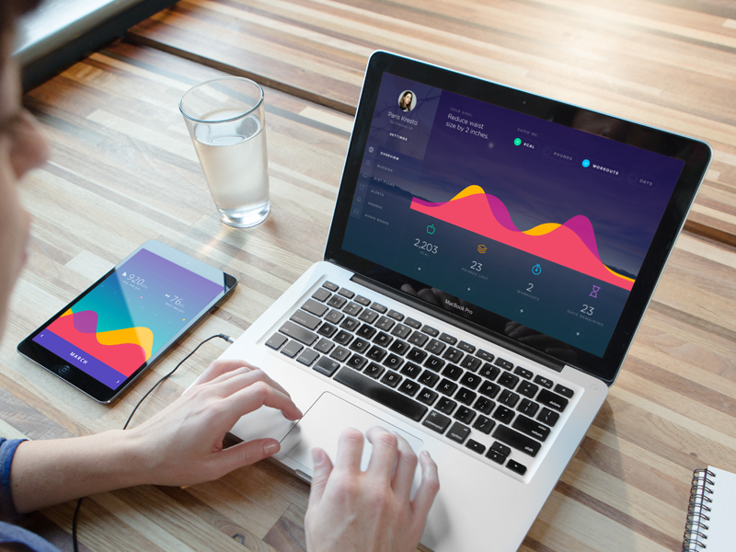
3.3 Sustainability
3.3.1 Benefits, Cost & Future
Benifit
Make friends
Less stress on parking space
3. Save moeny
Cost
Simple and Low
Future
CS hour and AOB
Delivery
3. Taxi together
Notes:
Friends: spread networking
Parking: parking spots are limited, expensive fee
Save moeny: driver receives reasonable transaction fare as compensation, passenger pay less for a ride(compare to didi uber)
Cost: we provide a simple sharing riding platform in #Red, so that we don’t have to buy and install any extra device and service from the third person and vendors
Future: 1. prize and award base on the review of the ridesharing users
2. delivery mails, files or items between colleagues
3. book a taxi together

Slide 20

Thank you!

